Slide 1

DDS Attrition Analysis
Team DataTex

Slide 2

Introduction
DDSAnalytics: Using Data to Solve Problems
Solutions for Fortune 1000 Companies
Workforce Planning
Employee Training Program
Identifying High-Potential Employees
Reducing Turnover
Data Interpretation
Notes:
DDSAnalytics is a Data Analytics company that reviews company data to provide insights and offer solutions.

Slide 3
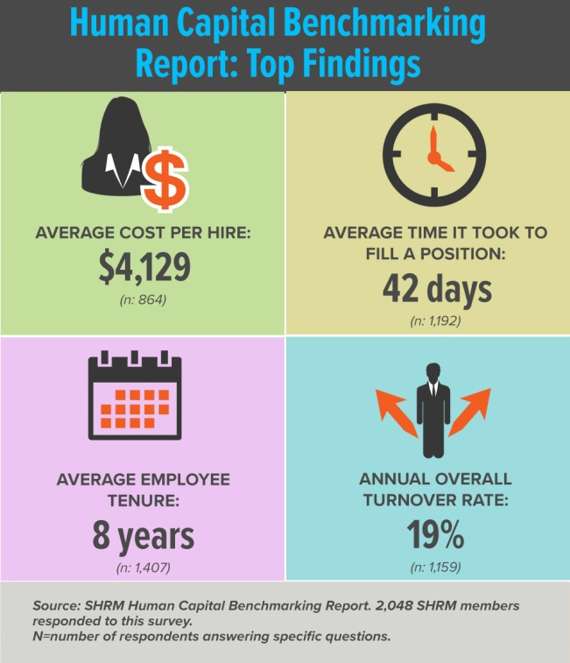

Cost of Attrition - 2016
Costs Per Hire $4,129
Time to Fill 42 days
Employee Tenure 8 Years
Annual Turnover Rate 19%
Notes:
Currently ACME’s Employee Tenure is estimated at 7 Years and Annual Turnover Rate at 16%

Slide 4
Naïve-Bayes: Variable Exploration
Probabilistic Machine Learning Algorithm
Assumes features are independent of each other
Variable | P(Y|X)
BusinessTravel - Travel Rarely | 0.66
Department - Research & Develoment | 0.56
DistanceFromHome - Under 10 | 0.56
Education - Bachelor Below | 0.42
Gender - Male | 0.63
JobInvolvement - High | 0.53
MonthlyIncome - Under 5,000 | 0.69
MaritalStatus - Single | 0.51
NumCompaniesWorked - Less_than_5 | 0.72
YearsWithCurrManager - Five_or_Less | 0.74
PercentSalaryHike - Less_than_15% | 0.56
YearsInCurrentRole - Five_or_Less | 0.77

Slide 5
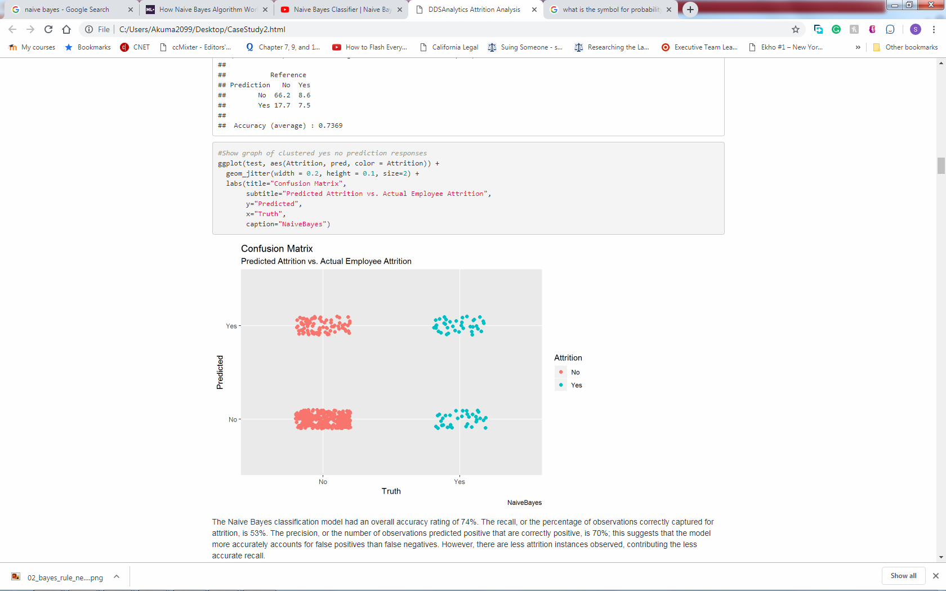
Naïve-Bayes: Prediction & Validation
Models Statistics
Accuracy: 74%
Recall: 53%
Precision: 70%

Slide 6
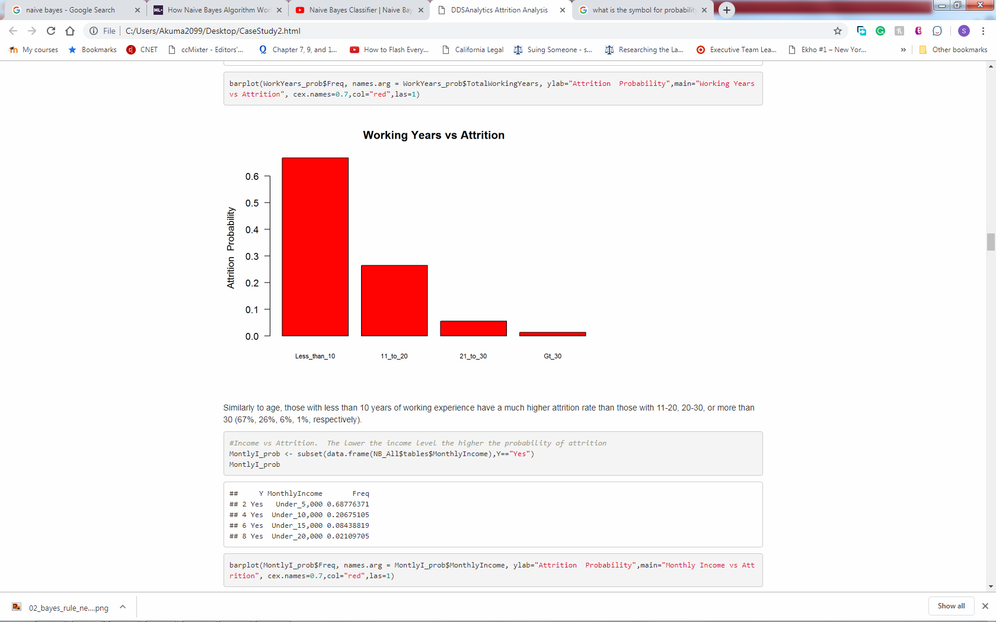
Other Findings
Men have a higher attrition rate than women (63% vs. 37%)
Singles have a higher attrition rate at 51% than married (35%) or divorced individuals (14%)
Employees with no stock options have a higher attrition rate 65% than those with.
Those with less then 10 years of work experience have greater attrition rates than those with more.

Slide 7
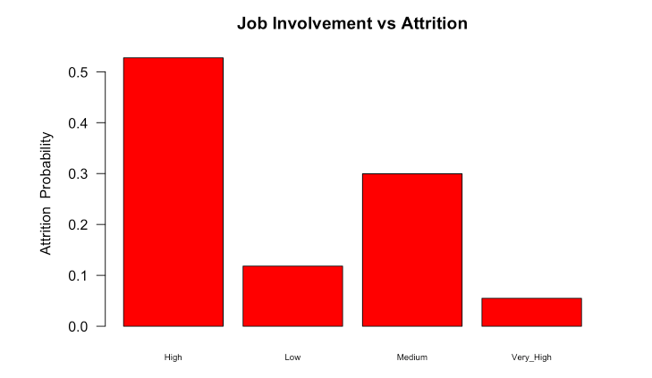
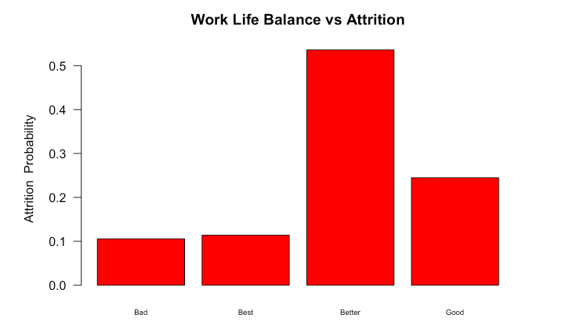
Other Findings
Attributes based on rankings tend to have higher attrition rates for middle ranks

Slide 8
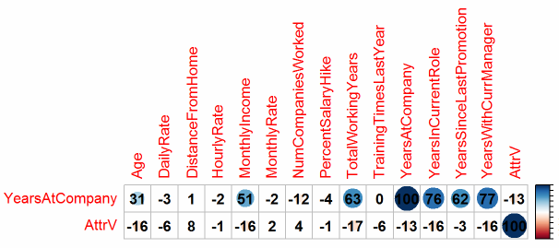
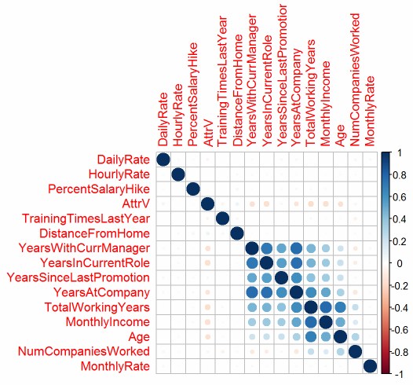
Exploratory Data Analysis
Exclusion of Unnecessary Variables
"Standard Hours", "Over 18“, "Employee Count”, etc.
Preliminary Correlation Tests
Correlation Tests of Continuous Variables

Slide 9
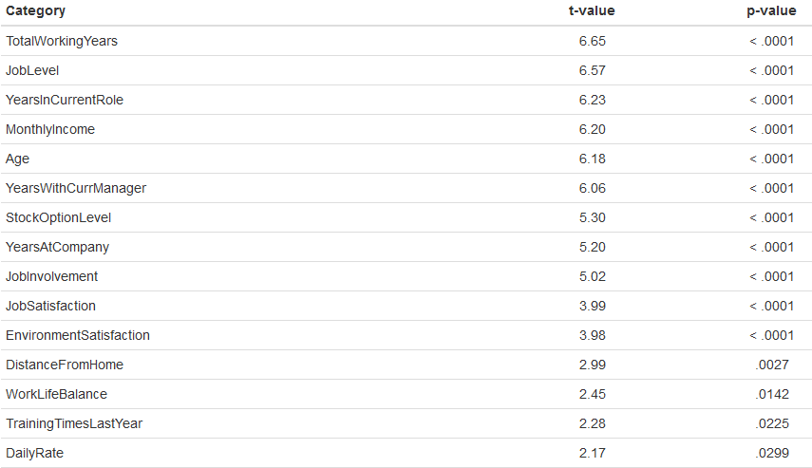
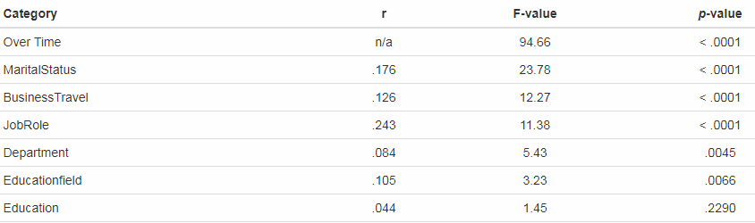
Analysis of Significance
t-tests for significance of distributions
ANOVA for Analysis of Categorical Variance

Slide 10
Preliminary Variable Selection
Based on the Exploratory Analysis the Following Variables Emerged as
Variable | p-value
TotalWorkingYears | < .0001
JobLevel | < .0001
YearsInCurrentRole | < .0001
MonthlyIncome | < .0001
Age | < .0001
YearsWithCurrManager | < .0001
StockOptionLevel | < .0001
YearsAtCompany | < .0001
JobInvolvement | < .0001
JobSatisfaction | < .0001
EnvironmentSatisfaction | < .0001
Over Time | < .0001
MaritalStatus | < .0001
BusinessTravel | < .0001
JobRole | < .0001
DistanceFromHome | 0.0027
Department | 0.0045
Educationfield | 0.0066
WorkLifeBalance | 0.0142
TrainingTimesLastYear | 0.0225
DailyRate | 0.0299

Slide 11
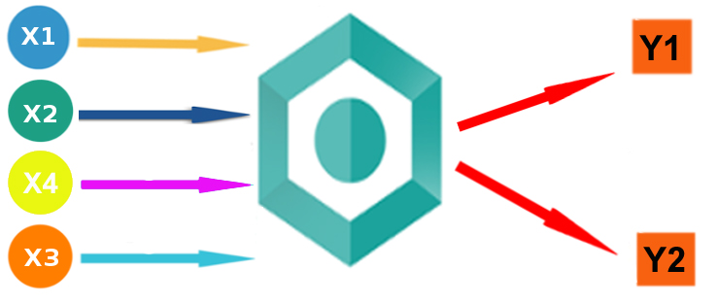
Logistic Regression
Classification Regression for Binary Outputs
Assumptions
Additive relationship between the predictors and the natural log odds of response.
Normality, Equal Variance, Independence
Overtime, Marital Status, Total Working Years, Business Travel, Distance From Home, Environment Satisfaction, Job Involvement, Job Role, Job Satisfaction, Marital Status, Num Companies Worked, Total Working Years, Overtime, Relationship Satisfaction

Slide 12


Model Selection
Foreword Selection
Begins with an empty model
Adds in variables one by one
Backward Selection
Begins with all variables then
each one is deleted one at a time
Top Variables
Marital Status
Overtime
Total Working Years

Slide 13
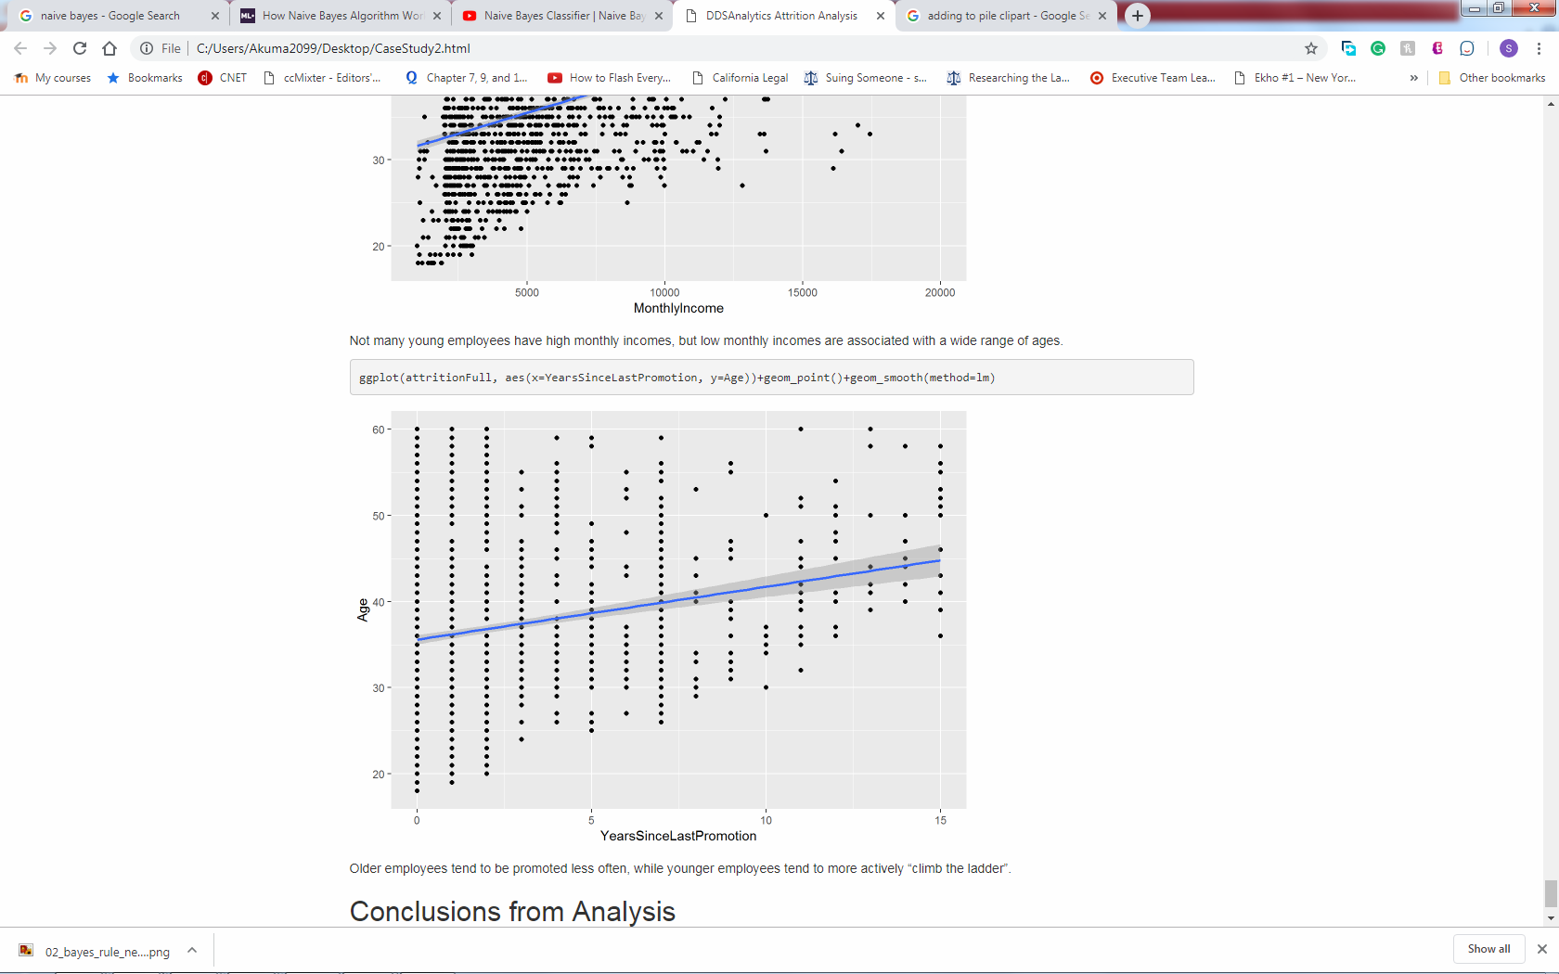
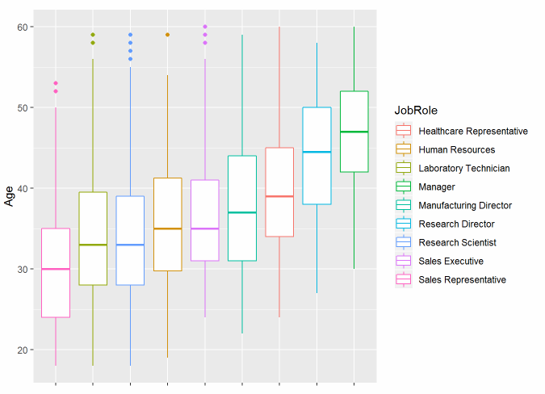
Other Job Role Trends
Older employees tend to be promoted less often
Sales Representatives tend to be the youngest
Managers and Directors tend to be older
Healthcare Representatives tend to be older than Manufacturing Directors

Slide 14
Conclusions
Top 3 Factors that Contribute to Turnover: Overtime, Marital Status, and Total Working Years
External/personal factors contribute as well as internal/job function factors
Variables that are correlated with entry level positions/age (work experience, perk eligibility, marital status) lead to higher attrition

